Slide 1

CROSS-SELL AND UPSELL BEST PRACTICES
TRACKING/METRICS
LEVERAGING EMC CONTENT
RESOURCE GUIDE
RECOMMENDED READING
QUESTIONS?
QUICK LINKS
marketingacademy@emc.com
Marketing Center
Digital Marketing Platform
Marketing Academy

Slide 2


Leveraging emc content
RESOURCE GUIDE
© Copyright 2015 EMC Corporation. All rights reserved.

Slide 3


RESOURCE GUIDE
Marketing Academy Course: account-based marketing
Learn about account targeting techniques, the important “segment of one” concept; and why sales collaboration is an essential part of success for this practice.
Visit the Marketing Academy
© Copyright 2015 EMC Corporation. All rights reserved.
3
Notes:
Content taken from: Digital Marketing strategies_FINAL.ppt Slide: 4

Slide 4

RESOURCE GUIDE
Marketing academy course: integrated digital marketing
Learn how to leverage search, mobile, email, paid media and other digital tactics to optimize your digital marketing mix.
Visit the Marketing Academy
© Copyright 2015 EMC Corporation. All rights reserved.
4
Notes:
Content taken from: Digital Marketing strategies_FINAL.ppt Slide: 4
Link view the course to marketing academy homepage

Slide 5

RESOURCE GUIDE
Technology refresh selling guide
This online resource was created by EMC to helps partners build technology refresh campaigns around VNX, VMAX, and Isilon products and also upsell with complementary solutions.
Document: Why You Should Upgrade Your Clariion Or Celera To A Next Generation VNX
Visit the Selling Guide
© Copyright 2015 EMC Corporation. All rights reserved.
5
Notes:
Content taken from: Digital Marketing strategies_FINAL.ppt Slide: 4

Slide 6
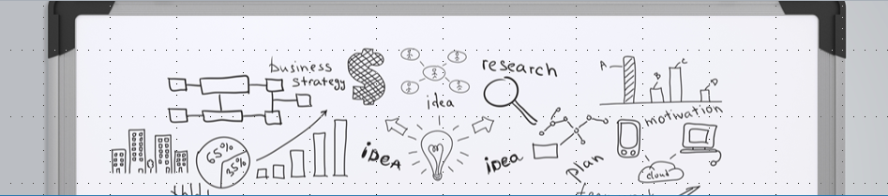

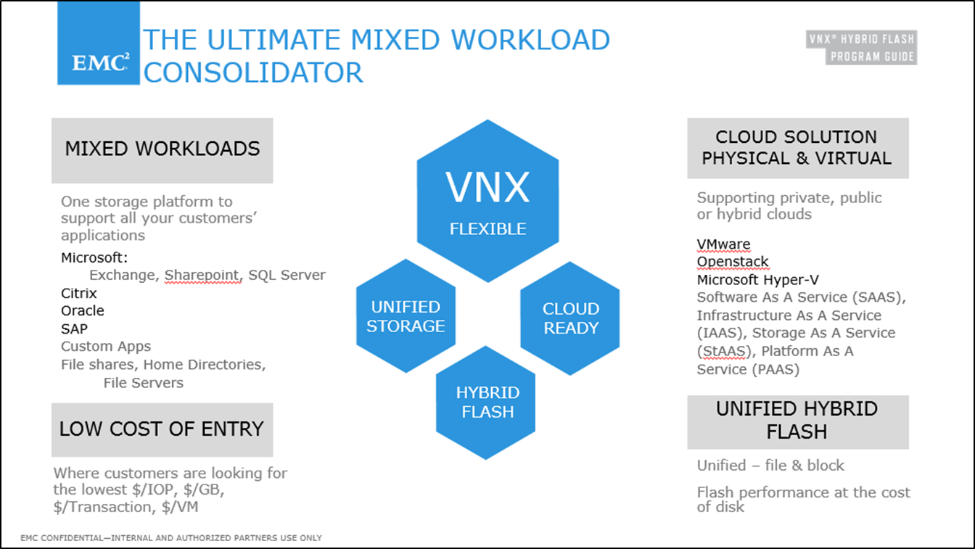
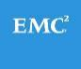
EMC NEW WORKLOADS EXAMPLE
Download this file by
selecting the below icon:
© Copyright 2015 EMC Corporation. All rights reserved.
6
Notes:
Before you execute your campaign, you must determine which metrics you’ll be measuring to gauge the success of your efforts. Some common metrics for cross-sell and upsell campaigns include:
(CLICK) an increase in average sales volume per customer, measured in dollars or units;
(CLICK) expansion of sales breadth, which is measured by the number of products or services for each customer;
(CLICK) a decrease in customer attrition. Conversely, higher-than-normal attrition rates can mean cross-selling and upselling attempts have been ineffective.;
(CLICK) improvement in aggregate cross-selling ratio, which is measured by the number of products or services divided by the number of clients;
(CLICK) and increased conversions from marketing-qualified leads to sales-qualified leads.

Slide 7
Tracking/metrics/analyTics
RESOURCE GUIDE
© Copyright 2015 EMC Corporation. All rights reserved.

Slide 8
POTENTIAL SUCCESS METRICS
Average sales volume increases per customer by X%
Number of products/services increases per customers by X%
Customer attrition decreases by X%
Aggregate cross-selling ratio improves by X%
Increased conversions from marketing-qualified leads to sales-qualified leads (MQL to SQL)
© Copyright 2015 EMC Corporation. All rights reserved.
8
Notes:
Before you execute your campaign, you must determine which metrics you’ll be measuring to gauge the success of your efforts. Some common metrics for cross-sell and upsell campaigns include:
(CLICK) an increase in average sales volume per customer, measured in dollars or units;
(CLICK) expansion of sales breadth, which is measured by the number of products or services for each customer;
(CLICK) a decrease in customer attrition. Conversely, higher-than-normal attrition rates can mean cross-selling and upselling attempts have been ineffective.;
(CLICK) improvement in aggregate cross-selling ratio, which is measured by the number of products or services divided by the number of clients;
(CLICK) and increased conversions from marketing-qualified leads to sales-qualified leads.

Slide 9
Recommended reading
RESOURCE GUIDE
© Copyright 2015 EMC Corporation. All rights reserved.

Slide 10

RECOMMENDED READING
RESOURCE GUIDE
The Moment of Truth in Customer Service. McKinsey Quarterly. February 2006
The Dark Side of Cross-Selling. Harvard Business Review. December 2012
Exploring The Cutting-Edge: Predictive Marketing Analytics. Marketing Land Blog. February 2015
75 Digital Marketing Stats From Salesforce Marketing Cloud Research. Salesforce Marketing Cloud Blog. November 2014
© Copyright 2015 EMC Corporation. All rights reserved.
10

